Slide 1
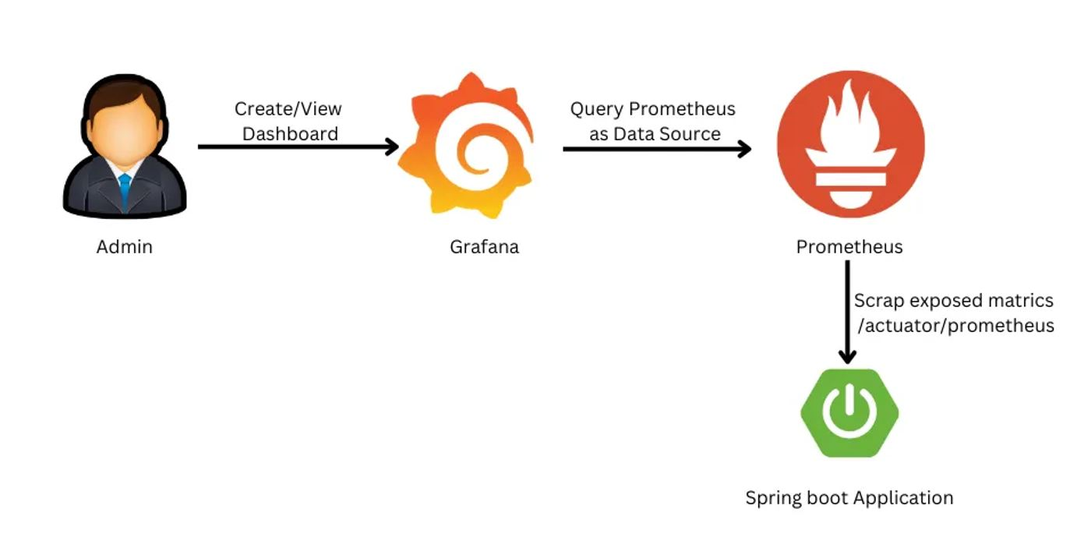

Spring Boot Metric Micrometer, Prometheus, Grafana
www.jmaster.io/course/microservices-with-spring-cloud

Slide 2
Spring Boot Actuator
Many production-ready features
Expose operational information about the running application — health, metrics, info, dump, env, etc.
Built-in endpoints and more, exposed over HTTP or JMX
Easy configure and customize with spring boot project

Slide 3
Micrometer
Vendor-neutral application observability facade (Unified Abstract API) in JVM apps
Timers, gauges, counters, distribution summaries, and long task timers with a dimensional data
Pre-configured Bindings: caches, the class loader, garbage collection, etc…
Integrated into Spring Actuator
Support most popular observability systems: CloudWatch, Datadog, Prometheus, OpenTelemetry, etc…

Slide 4
Prometheus
Prometheus is power your metrics and alerting with the leading open-source monitoring solution.
Dimensional data, power query, time series storage, alert, support client libs, easy integration
Integrated into Spring Actuator, Micrometer Prometheus

Slide 5

Grafana
Dashboard anything. Observe everything.
Query, visualize, alert on, and understand your data form mutli-datasources. Grafana can create, explore, and share all of your data through beautiful, flexible UI.

Slide 6
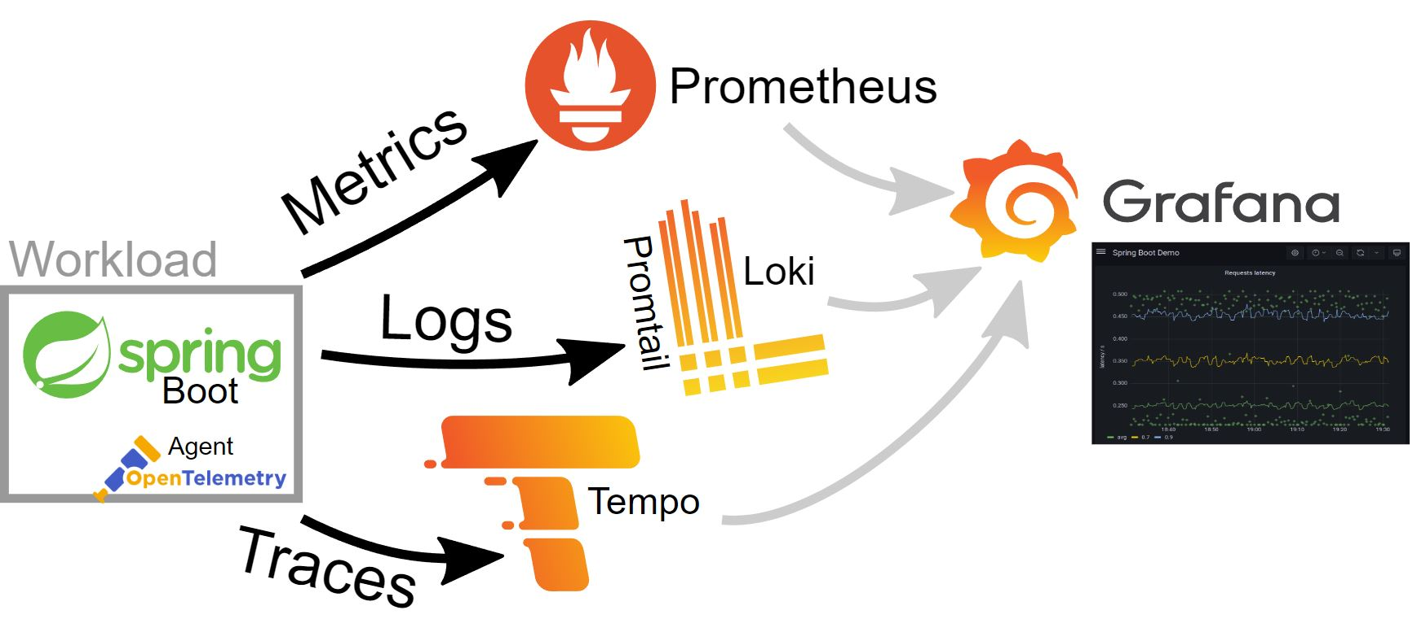
Grafana System

Slide 7
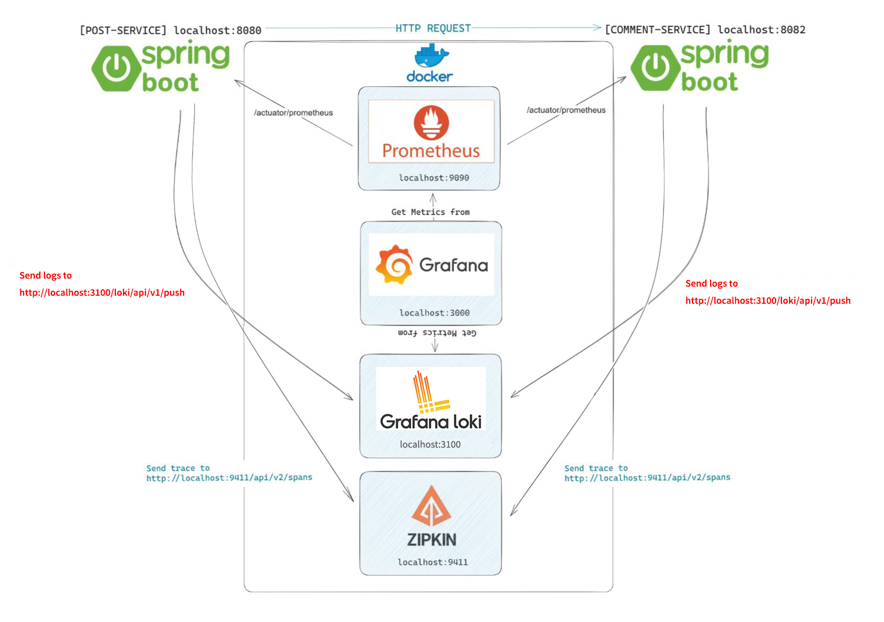
Observability System

Slide 8
Prometheus, Grafana
https://docs.spring.io/spring-boot/docs/current/reference/html/actuator.html
https://micrometer.io/
https://grafana.com/

